Slide 1

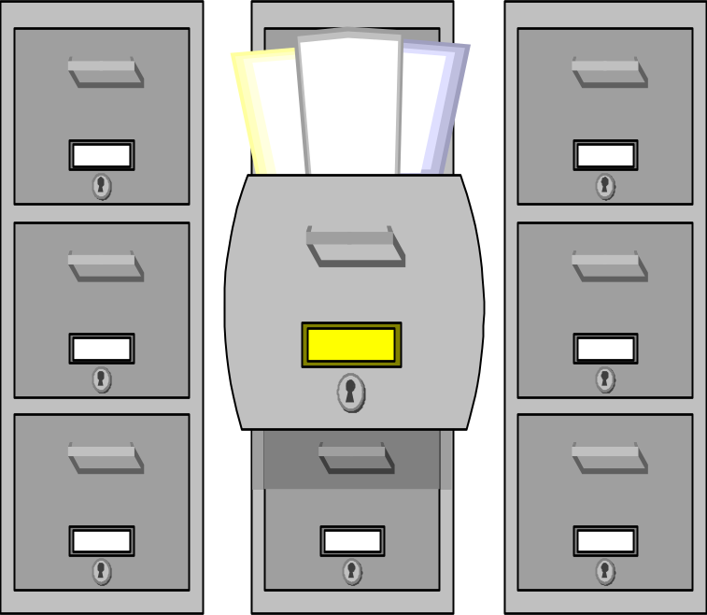
DATABASE DESIGN

Slide 2
Observations about DATA
123
abc
Data are the most stable part of an organization’s information system
Permanent data are stored in tables within a database
Permanent storage of data is also referred to as persistent data
xyz
789

Slide 3

Why do we need database design?
123
abc
A quality I.S. demands a quality db design
Avoid redundancy (duplication) of data
Insures simple db structures which allow for maximum effective utilization of the data
xyz
789

Slide 4
Analysis to Design
(Logical model to Physical model)
Student
iD
name
Major
code
name
Analysis
(Logical)
Design
(Physical)
note:
majorCode
is a
synonym for
code
Student
iD
name
majorCode
Major
code
name
Notes:
9

Slide 5
Example of Duplicate Data
(notice the redundancy in the data values)
First Name
Last Name
Student ID
Course Taken
Grade
John
Adams
123-45-6789
IDS-306
B
John
Adams
123-45-6789
IDS-406
A
John
Adams
123-45-6789
IDS-315
B+
Susan
Baker
987-65-4321
IDS-250
A
Susan
Baker
987-65-4321
IDS-315
A-
Susan
Baker
987-65-4321
IDS-306
B
Susan
Baker
987-65-4321
IDS-480
B
Kim
Le
789-12-3456
IDS-180
A
Kim
Le
789-12-3456
IDS-250
A

Slide 6
Distribute the data into 2 tables
(notice the reduction in redundancy)
Last
Name
Course
Taken
First
Name
Grade
Student ID
Student ID
123-45-6789
IDS-306
B
John
Adams
123-45-6789
123-45-6789
IDS-406
A
Susan
Baker
987-65-4321
123-45-6789
IDS-315
B+
Kim
Le
789-12-3456
987-65-4321
IDS-250
A
987-65-4321
IDS-315
A-
987-65-4321
IDS-306
B
987-65-4321
IDS-480
B
789-12-3456
IDS-180
A
789-12-3456
IDS-250
A
Foreign Key

Slide 7
Hierarchical Components of Persistent Data
Bits
0 1 1 1 0 0 0 1
Bytes
A, B, ... Z, 0,1...9, #, &, $, etc...
Attributes
Template
First Name Middle Initial Last Name Social Security Number State
Ronald J Norman 559-65-8213 CA
Values, states, or instances
First Name Middle Initial Last Name Social Security Number State
Ronald
Rashmi
James
Susan
J
B
R
L
Norman
Kumar
Logan
Johnson
559-65-8213
371-48-4562
559-63-8472
243-74-5219
CA
MI
OR
NY
Records
(each row is a record)

Slide 8
TABLES (Individual Files or all part of a database)
Table #1
Student
Information
First Name Middle Initial Last Name Social Security Number State
Ronald
Rashmi
James
Susan
J
B
R
L
Norman
Kumar
Logan
Johnson
559-65-8213
371-48-4562
559-63-8472
243-74-5219
CA
MI
OR
NY
Course Number Course Name Units Department
Table #2
Course
Information
Act102
Bio101
Chm109
Eco104
Eng100
MIS111
Mkt114
PEd118
Phl108
Soc105
Accounting Principles
Intro to Biology
Organic Chemistry
Macro Economics
Beginning English
Intro. to Computers
Principles of Marketing
Beginning Golf
Philosophy
Cultural Changes
3
3
3
3
3
3
3
1
3
3
Accounting
Biology
Chemistry
Economics
English
M.I.S.
Marketing
Phys. Educ.
Philosophy
Sociology
Department Department Head Telephone No. of Majors
Accounting
Biology
Chemistry
Economics
English
M.I.S.
Marketing
Phys. Educ.
Philosophy
Sociology
J. Morgan
S. Tishman
P. Dayson
R. Kumar
J. Amar
K. Kettleman
A. Winters
T. Tolner
A. Hayley
B. O’Neal
594-2348
594-4459
594-7728
594-0923
594-8276
594-1010
594-2034
594-2229
594-9011
594-3927
275
110
120
75
60
175
140
225
150
70
Table #3
Department
Information

Slide 9

Seven Table (file) Types
Master
Transaction
“Table”
Temporary
Log
Mirror
Archive

Slide 10
Master Table -
reference (foundational) data for the information system
Student Master Table
Social
Security First Middle Last
Number Name Initial Name Zipcode Telephone etc.......
123-45-6789
321-54-6638
559-38-8921
Jim
Mary
Minder
R
J
Thomas
Wilson
Chang
91942
92020
91938
464-3782
571-2190
291-8374
etc...
etc...
etc...

Slide 11
Transaction Table -
holds the business activity for the information system
Course Registration Transaction Table
Course Course Course
Transaction
Serial # Number Section # Student # Semester Date/Time
10294
29832
42198
17620
10294
28734
44398
Eng100
MIS111
Act102
Soc118
Eng100
PhE119
Chm107
5
2
2
1
5
3
2
559680843
525987391
371234959
559680843
224942874
104873298
525987391
Spr95
Spr95
Spr95
Spr95
Spr95
Spr95
Spr95
941115/1202
941115/1202
941115/1202
941115/1203
941115/1203
941115/1203
941115/1204

Slide 12
“Table” Table -
Static (relatively) table of values
State Code Table
Sales Tax Code Table
State Code State Name
Sale Range Sales Tax
.00 - .09
.10 - .24
.25 - .39
.40 - .54
.55 - .69
.70 - .84
.85 - .99
.00
.01
.02
.03
.04
.05
.06
AL
AZ
CA
CO
WY
Alabama
Arizona
California
Colorado
Wyoming

Slide 13
Temporary Table - created and used briefly OR over an
extended period of time to help the information system
accomplish its intended purpose
Log Table - contains copies of Master and Transaction
table records for audit, statistical, and recovery purposes
Mirror Table - an exact copy of one of the other types
of tables used to minimize or eliminate information
system downtime
Archive Table - a historical copy of a master, transaction,
“table”, or log table

Slide 14
DATABASE DESIGN
Database = one or more related tables (files)
Folder = Metaphor for holding a database
Data Structures - another name for records
    Simplicity
    Non-redundancy
Data Structure Modeling:
    Entity-Relationship Diagrams
    Object Models:
      Generalization-Specialization Structure
      Whole-Part Object Connection w/constraints
      Object Connection w/constraints

Slide 15
Attribute (field) Types
Key - used to identify & find one or more records in a table (file)
  Primary - unique; identifies one specific record; table may
    need to combine two or more attributes to accomplish this
    (Examples: customer #, student #, VIN #, UPC #)
  Secondary - non-unique - may identify multiple records;
    another way to identify one or more records in a file
    (Examples: customer name, zip code, city, last name)
  Foreign - attributes added to a table to associate a record in the
    table with one or more records in one or more OTHER tables
    (Example: “Courses Taken” table has a student # in it)
Descriptor - characteristics that describe the data; some of these attributes are used for Audit & Control purposes, Security purposes, or programmer consistency & control purposes

Slide 16
Key Examples
Student Account Number
Bank Account Number
Vehicle ID Number
Credit Card Number
University Course Schedule Number
University Course Number + Section Number
Primary
(unique)
Student Last Name
Vehicle Type
State
Zipcode
Secondary
(non-unique)
Student Account Number -----> Courses Taken
Vehicle Type -----> Description of this Type
State -----> Table of State Codes & Descriptions
City ---> Table of valid zip codes for each city
Foreign
(association)

Slide 17
Key Attribute Examples
Key Attribute Name Instance (Value or State) Example
Student ID Number
Social Security Number
Vehicle ID Number
Course Number
VISA Card Number
Checking Account Number
Video Store Account Number
68372
559-68-0923
JA3XC52BONY002400
MIS-111
4128 0022 2048 2552
128-0049
Norm001

Slide 18
Foreign Key Example
Student Information Table* Course Information Table*
Student Name Student ID Number Student ID Number Course Number
Adams
Jones
Kumar
Lopez
Norman
Smith
Zumwalt
371-48-4326
559-62-0987
243-98-7615
337-89-6212
558-97-8221
557-33-5849
298-88-7643
557-33-5849
243-98-7615
558-97-8221
371-48-4326
298-88-7643
557-33-5849
558-97-8221
337-89-6212
243-98-7615
298-88-7643
559-62-0987
337-89-6212
Bio101
Bio101
Bio101
Eng103
Eng103
MIS111
MIS111
PE118
Phl125
Phl125
Phl125
Phl125
Foreign Key
* Note: Both of these tables would have additional attributes (columns)

Slide 19
Seven Table (file) Types
Master
Transaction
“Table”
Temporary
Log
Mirror
Archive
These different types of tables
have access and organization
needs/requirements…next page

Slide 20
Table Access & Organization
Table Access: Method of reading or writing records
Sequential - first to last, vice versa
Direct - any record
Table Organization: Method of storing records
Serial - based on arrival time of data
Sequential - based on sorted attribute(s)
Relative or Direct - based on an algorithm
Indexed - based on maintaining a sorted index of attribute values separate from the data

Slide 21
Serial File Organization
E-Mail InBox File
From Date Time Subject
1
2
3
4
5
6
Dean
President
JSmith
MChen
Dean
KHaddad
11/28/97
11/28/97
12/01/97
12/01/97
12/01/97
12/02/97
09:12
11:55
10:16
15:43
16:28
07:48
New Enroll
Discrim. Policy
Grade in Class
Research Paper
Faculty Mtg.
Personnel Mtg.
Based on arrival date & time attributes

Slide 22
Sequential File Organization
Table ordered by Student ID Number
Table ordered by Student (Last) Name
Student ID Number Student Name
Student ID Number Student Name
102-58-9762
204-78-7652
371-48-4133
450-22-9611
557-38-9120
558-56-6749
Smith, Fred
Baker, Jane
Haddad, Kamal
Chang, Minder
Rice, Jerry
Favre, Brett
204-78-7652
450-22-9611
371-48-4133
558-56-6749
557-38-9120
102-58-9762
Baker, Jane
Chang, Minder
Haddad, Kamal
Favre, Brett
Rice, Jerry
Smith, Fred

Slide 23
Student Master Table ordered by Student ID Number
Student ID Number Student Name
Insertion of new records
in a Sequential Table
102-58-9762
204-78-7652
371-48-4133
450-22-9611
557-38-9120
558-56-6749
Smith, Fred
Baker, Jane
Haddad, Kamal
Chang, Minder
Rice, Jerry
Favre, Brett
NEW Student Master Table
ordered by Student ID Number
Student ID Number Student Name
102-58-9762
204-78-7652
298-73-0912
371-48-4133
450-22-9611
557-38-9120
557-93-8247
558-56-6749
Smith, Fred
Baker, Jane
Jackson, Janet
Haddad, Kamal
Chang, Minder
Rice, Jerry
Carey, Mariah
Favre, Brett
Insert new students:
298-73-0912 Jackson, Janet
557-93-8247 Carey, Mariah

Slide 24
A discussion of the Direct (Relative) Table
Organization Method is in the text
but not planned for classroom discussion.

Slide 25
Conceptual Model of an Index Table Organization
Student ID # Index
102-58-9762 4
204-78-7652 6
298-73-0912 3
371-48-4133 1
450-22-9611 8
557-38-9120 7
557-93-8247 2
558-56-6749 5
Student Master Table
Student ID # Student Name Etc...
1
2
3
4
5
6
7
8
371-48-4133 Haddad, Kamal
557-93-8247 Carey, Mariah
298-73-0912 Jackson, Janet
102-58-9762 Smith, Fred
558-56-6749 Favre, Brett
204-78-7652 Baker, Jane
557-38-9120 Rice, Jerry
450-22-9611 Chang, Minder
Note: This Table will normally have
dozens of attributes.
1. Search Student Index Table to find Student ID Number.
2. Get Pointer Value and access that record in Student Master Table to
find the actual student record.

Slide 26
Relational Database Normalization

Slide 27
Relational Database
Normalization
“The process of simplifying complex data structures so that the resulting data structures will be more easily maintained and more flexible to meet present and future needs of the user.” (Norman, 1996)
Notes:
24

Slide 28
Relational Database
Normalization
“… data analysis uses a procedure called normalization to simplify entities, eliminate redundancy, and build flexibility into the data model.” (Whitten, 1989)
Notes:
25

Slide 29
Why Normalization?
Find entities (tables)
Avoid anomalies
Notes:
26

Slide 30
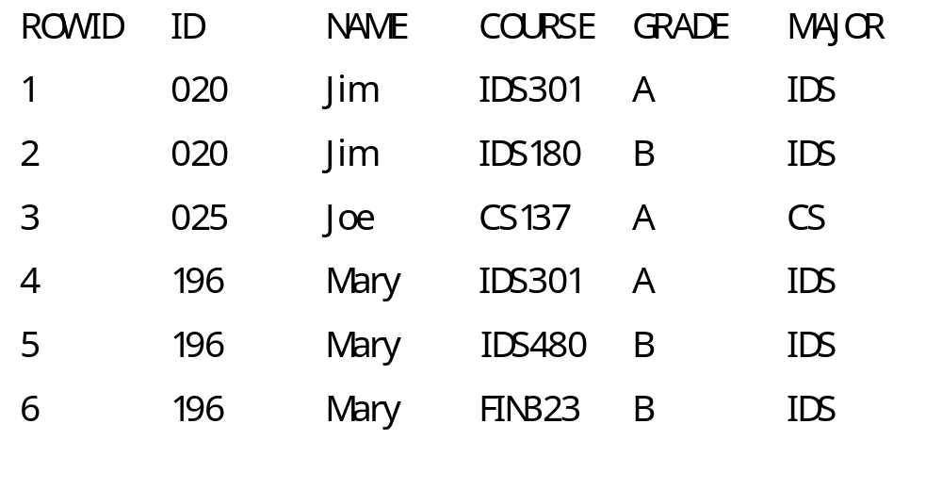
Sample Data
Notes:
27

Slide 31
Deletion Anomalies
Deletion anomalies: When a value for one attribute is unexpectedly removed when a value for another attribute is deleted.
E.g. deleting row 3 results in the ‘loss’ of the CS major
Notes:
28

Slide 32
Update Anomalies
Update anomalies: In order to effect a change to a single attribute, changes to multiple rows of a table must be made.
E.g. Rows 4-6 must be changed to accommodate a name change for ‘Mary’.
Notes:
29

Slide 33
Insert Anomalies
Insert anomalies: Need to store a value for an attribute but cannot because the value for another attribute is unknown.
E.g. cannot add a complete record for ‘Ron’, until he completes a class and receives a grade!
Notes:
30

Slide 34
E. F. Codd
Each attribute is dependent on the key, the whole key, and nothing but the key, … so help me Codd
Notes:
31

Slide 35
Order Number
ABC Incorporated
SALES ORDER FORM
Order Date
Customer Number
Customer Name
Street Address
City
State
Zip Code
Product Product Unit Total
Number Name Color Price Quantity Price
1
2
3
4
5
6
7
ORDER TOTAL
SALES TAX
SHIPPING
GRAND TOTAL
Come to ABC Incorporated for
all your technology needs.
Thank you for your patronage.
You are a valued customer.

Slide 36
Relational
Database
Normalization
Unnormalized
Data Structure
1.
Remove Attributes
that can have
multiple values
2.
Remove non-key
attributes that
are not fully,
functionally
dependent on all
attributes in the
primary key
(partial
dependency)
Data Structure in First Normal Form
Data Structure in Second Normal Form
3.
Remove attributes
that are uniquely
identified by another
non-key attribute
(transitive
dependency)
4th Normal Form
Boyce-Codd NF
5th Normal Form
Domain-Key NF
Data Structure in
Third Normal Form

Slide 37
Sales Order
Class with
Objects
SalesOrder
orderNumber (primary key)
orderDate
customerNumber
customerName
customerAddress
customerCity
customerState
customerZipcode
For each product ordered (up to 7)
productNumber
productName
productColor
productUnitPrice
productQuantity
productTotalPrice (derived)
orderTotal (derived)
orderTax (derived)
orderDelivery (derived)
orderGrandTotal (derived)
services

Slide 38
SalesOrder and ProductsOrdered Classes with Objects in First N.F.
SalesOrder
1.
Remove Attributes
that can have
multiple values
orderNumber (primary key)
orderDate
customerNumber
customerName
customerAddress
customerCity
customerState
customerZipcode
orderTotal (derived)
orderTax (derived)
orderDelivery (derived)
orderGrandTotal (derived)
1,7
1
services
ProductsOrdered
orderNumber (primary key)
productNumber (primary key)
productName
productColor
productUnitPrice
productQuantity
productTotalPrice (derived)
services

Slide 39
Order Number
ABC Incorporated
SALES ORDER FORM
Order Date
34820
12/02/97
Customer Number
Customer Name
Street Address
City
534
Norman Business Systems, Inc.
7150 University Blvd., Suite 218
San Diego
State
CA
Zip Code
92108
Product Product Unit Total
Number Name Color Price Quantity Price
1
2
3
4
5
6
7
IC-PENT
PS-220
KB-102
MO-675
HD-550
Intel Pentium CPU
220 V. Power Supply
102-key Keyboard
Mouse - Serial
550 MB Hard Disk
Bn
Sl
Tn
Tn
Sl
$675
$150
$ 75
$ 65
$325
1
1
1
2
1
$675
$150
$ 75
$130
$325
ORDER TOTAL
SALES TAX
SHIPPING
GRAND TOTAL
Come to ABC Incorporated for
all your technology needs.
Thank you for your patronage.
You are a valued customer.
$1,355
$ 95
$ 25
$1,475

Slide 40
SalesOrder
orderNumber (primary key)
orderDate
customerNumber
customerName
customerAddress
customerCity
customerState
customerZipcode
orderTotal (derived)
orderTax (derived)
orderDelivery (derived)
orderGrandTotal (derived)
34820
12/02/97
534
Norman Business Systems
7150 University Ave., Suite 218
San Diego
CA
92108
1355
95
25
1475
5
1
ProductsOrdered
orderNumber (primary key)
productNumber (primary key)
productName
productColor
productUnitPrice
productQuantity
productTotalPrice (derived)
34820
IC-PENT
Intel Pentium CPU
Bn
675
1
675
34820
PS-220
etc...
Sl
150
1
150
34820
KB-102
etc...
Tn
75
1
75
34820
MO-675
etc...
Tn
65
2
130
34820
HD-550
etc...
Sl
325
1
325
Sample Objects for SalesOrder and ProductsOrdered

Slide 41
Sample ProductsOrdered Objects for Several SalesOrders
34820
HD-550
etc...
Sl
325
1
325
ProductsOrdered
34820
MO-675
etc...
Tn
65
2
130
34820
KB-102
etc...
Tn
75
1
75
34820
PS-220
etc...
Sl
150
1
150
orderNumber (primary key)
productNumber (primary key)
productName
productColor
productUnitPrice
productQuantity
productTotalPrice (derived)
34820
IC-PENT
Intel Pentium CPU
Bn
675
1
675
services
(continued)
34823
HD-550
etc...
Sl
325
3
975
34823
IC-80486
Intel 80486
CPU
Bn
325
2
650
34821
PS-220
220 V. Power
Supply
Sl
150
3
450
34822
KB-102
102-key
Keyboard
Tn
75
4
300
34821
IC-80486
Intel 80486 CPU
Bn
325
10
3,250

Slide 42
Sales Order Data Structure
in Second Normal Form
SalesOrder
orderNumber (primary key)
orderDate
customerNumber
customerName
customerAddress
customerCity
customerState
customerZipcode
orderTotal (derived)
orderTax (derived)
orderDelivery (derived)
orderGrandTotal (derived)
2.
Remove non-key
attributes that
are not fully,
functionally
dependent on all
attributes in the
primary key
(partial
dependency)
1,7
services
1
Product
ProductsOrdered
productNumber (primary key)
productName
productColor
productUnitPrice
0,m
orderNumber (primary key)
productNumber (primary key)
productUnitPrice
productQuantity
productTotalPrice (derived)
1
services
services

Slide 43
Sample Objects For Second
Normal Form Sales Order
SalesOrder
orderNumber (primary key)
orderDate
customerNumber
customerName
customerAddress
customerCity
customerState
customerZipcode
orderTotal (derived)
orderTax (derived)
orderDelivery (derived)
orderGrandTotal (derived)
1,m
1
etc.....
services
ProductsOrdered
orderNumber (primary key)
productNumber (primary key)
productUnitPrice
productQuantity
productTotalPrice (derived)
34820
IC-PENT
675
1
675
Product
productNumber (primary key)
productName
productColor
productUnitPrice
IC-80486
Intel Pentium CPU
Bn
675
PS-220
220 V. Power Supply
Sl
150
KB-102
102-key Keyboard
Tn
75
MO-675
Mouse - Serial
Tn
65
HD-550
550 MB HD
Sl
325
services

Slide 44
SalesOrder
Customer
orderNumber (primary key)
orderDate
customerNumber
orderTotal (derived)
orderTax (derived)
orderDelivery (derived)
orderGrandTotal (derived)
1
customerNumber (primary key)
customerName
customerAddress
customerCity
customerState
customerZipcode
0,m
1,m
services
services
3.
Remove attributes
that are uniquely
identified by another
non-key attribute
(transitive
dependency)
1
ProductsOrdered
Product
orderNumber (primary key)
productNumber (primary key)
productUnitPrice
productQuantity
productTotalPrice (derived)
productNumber (primary key)
productName
productColor
productUnitPrice
0,m
1
services
services
Sales Order Data Structure in Third Normal Form

Slide 45
Order Order Customer OrderTotal OrderTax OrderDelivery OrderGrand
Number Date Number (derived) (derived) (derived) Total (derived)
SalesOrder
34820 12/02/95 534 1355 95 25 1475
34821 12/02/95 871 7200 504 15 7719
34822 12/02/95 290 300 21 17 338
OrderNumber ProductNumber ProductUnitPrice ProductQuantity ProductTotalPrice
(derived)
ProductsOrdered
34820 IC-PENT 675
34820 PS-220 150
34820 KB-102 75
34820 MO-675 65
34820 HD-550 325
34821 IC-80486 325
34821 PS-220 150
34822 KB-102 75
1
1
1
2
1
10
3
4
675
150
75
130
325
6750
450
300
ProductNumber ProductName ProductColor ProductUnitPrice
IC-PENT Intel Pentium CPU Bn 675
IC-80486 Intel 80486/DX4 CPU Sl 325
HD-550 550 MB Hard Disk Sl 325
HD-1GB 1-GB Hard Disk Sl 550
KB-102 102-key Keyboard Tn 75
MN-209 NEC .29 Monitor Tn 375
MO-675 Mouse - Serial Tn 65
PS-220 220 V. Power Supply Sl 150
Product
Customer Customer Customer Customer Cust Customer
Number Name Address City St Zipcode
107 Chips ‘N Bits 824 E. Main Street Pasadena CA 92875
290 Computers 4 U 925 W. Broadway Avenue Tucson AZ 85721
534 Norman Business Systems 7150 University Ave., Suite 218 San Diego CA 92108
871 Computers Unlimited 2978 So. Grand Avenue Lansing MI 48286
Customer

Slide 46
Normalization Summary
Conversion to First Normal Form
(remove multi-valued attributes)
Conversion to Third
Normal Form
A B E F
primary
key
C D
primary keys
C D
(Remove attributes uniquely identified
by another non-key attribute
(transitive dependencies)
C D
A C D
A C D
A C D
A C D
A B C D E F
A B C
Conversion to Second Normal Form
(Remove non-key attributes not fully, functionally
dependent on all attributes in the key
[partial dependencies])
primary key
A B C
A B C D
primary keys
primary keys
A D
A B
B C
primary key
= dependency
= dependency

Slide 47
Normalization Example
Course Registration Record
Id _________ Name __________
Address ___________________
_____________________
Course Request List
Course Title Units Grade
____________________________
____________________________
____________________________
Year ________ Term ______
Class Level ___ Fees _______
Notes:
32

Slide 48
Why Object-Oriented Database Management Systems?
OODB supports new types of applications that no relational, network, or hierarchical database system is well suited.
Object-oriented languages are rapidly gaining acceptance, and OODB has proven to be able to support the persistent data needs better than the conventional record-based database models (relational, network, and hierarchical).
The majority of conceptual language-design work from object-oriented programming languages carries over easily to OODB.
Information systems are becoming more and more rigorous and sophisticated.

Slide 49
Object-Oriented Data Model
Traditional
Database Systems
Semantic
Data Model
Object-Oriented
Programming
Persistence
Sharing
Query Language
Transaction
Processing
Aggregation
Generalization
Complex objects
Object identity
Classes &
Methods
Encapsulation
Inheritance
Extensibility
Object-Oriented Data Model

Slide 50
Common Characteristics of an Object Data Model
Supports the representation of complex objects
Extensibility; allows the definition of new data types as well as operations that act on them
Encapsulation of data and methods
Inheritance of data and methods from other objects
Object identity

Slide 51
The Object-Oriented Database
Management System Manifesto Rules
The system must:
1. Support complex objects
2. Support object identity
3. Allow objects to be encapsulated
4. Support types or classes
5. Support inheritance
6. Avoid premature binding
7. Be computationally complete
8. Be extensible
9. Be able to remember data locations
10. Be able to manage very large databases
11. Accept concurrent users
12. Be able to recover from hardware/software failures
13. Support data query in a simple way

Slide 52
Strengths and Weaknesses of an OODB
1. Data Modeling
2. Non-homogenous data
3. Variable length and
long strings
4. Complex objects
5. Version control
6. Schema evolution
7. Equivalent objects
8. Long transactions
9. User Benefits
Strengths
Weaknesses
1. New problem solving approach
2. Lack of a common data model
with a strong theoretical foundation
3. Limited success stories

Slide 53


